Slide 1

Algorithms, Variables & Operators. Data Types

Slide 2
Homework Check and Recap
Your time to speak !

Slide 3
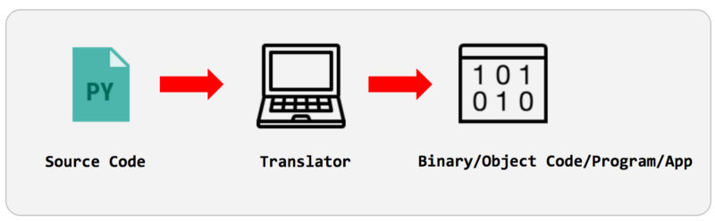
Language Translators
Interpreters: execute line by line
Compilers: execute whole binary file
Hybrids: both, ex: Java
Assemblers: Assembly to binary
Notes:
By Our Audience we mean: describe the typical demographics in the classrooms like we have everyone from age 15 till 40+, boys and girls, working and students, etc. THis program is designed for everyone

Slide 4
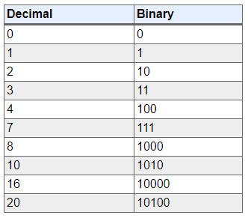
Binary Calculations
Notes:
Bir nece ededi 2lik say sistemine convert edin və əksinə!!!

Slide 5
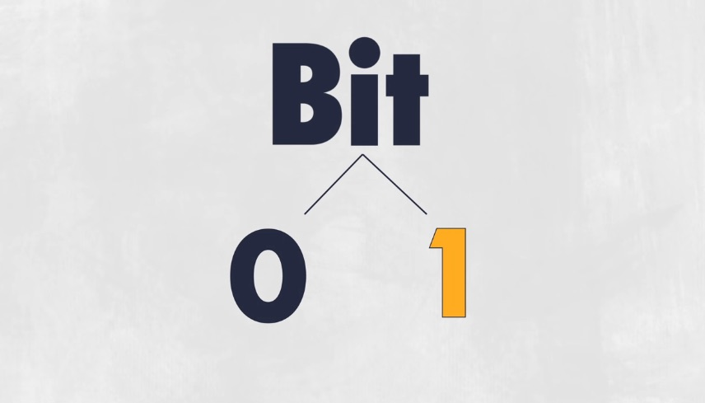

Slide 6
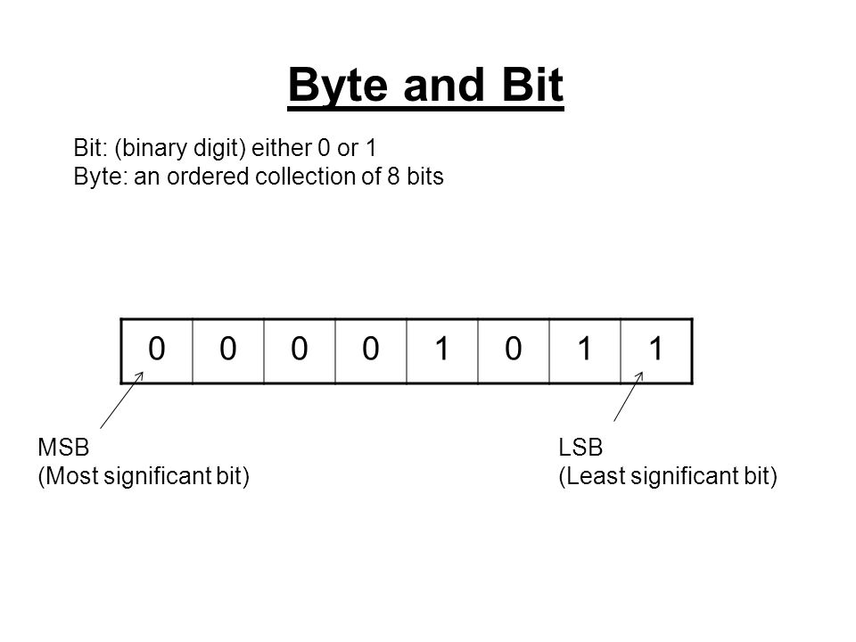

Slide 7
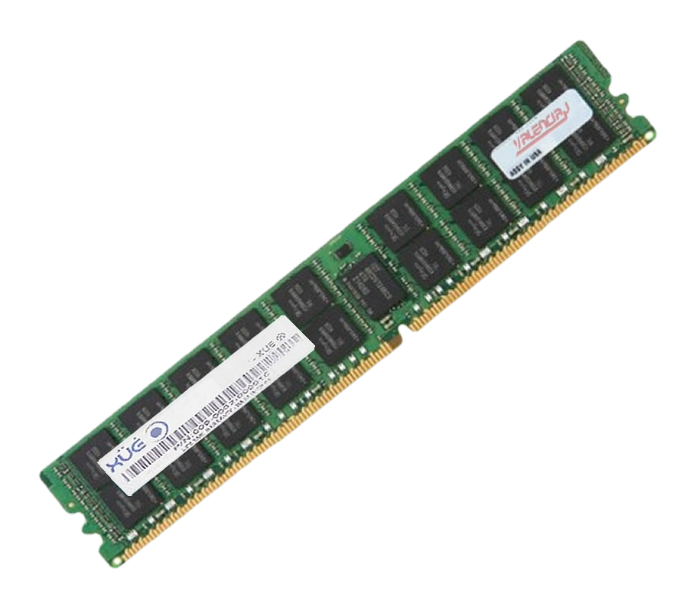
RAM
Random-access memory (RAM is a form of computer memory that can be read and changed in any order, typically used to store working data and machine code

Slide 8
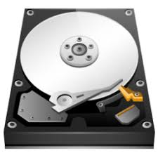
Hard-Drive
A hard disk drive (HDD), hard disk, hard drive, or fixed disk is an electro-mechanical data storage device that uses magnetic storage to store and retrieve digital data using one or more rigid rapidly rotating platters coated with magnetic material.

Slide 9
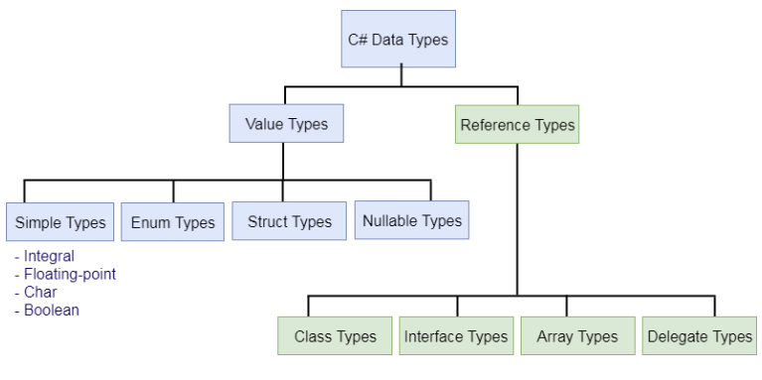
Data Types
Notes:
By Our Audience we mean: describe the typical demographics in the classrooms like we have everyone from age 15 till 40+, boys and girls, working and students, etc. THis program is designed for everyone

Slide 10
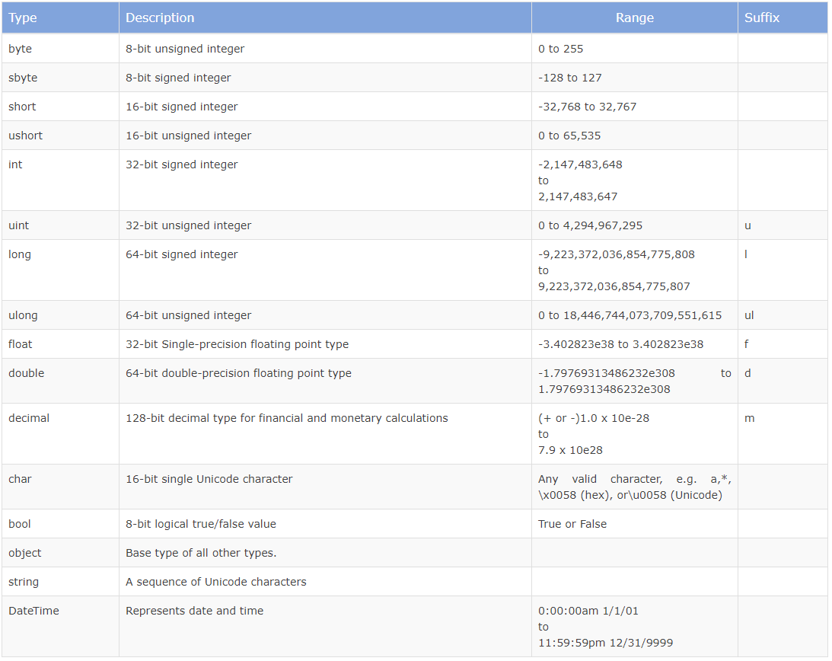
Data Types

Slide 11
Variables and Operators
+.-,*,/,%, <> =, etc.
VAR
Declaration and Overwriting
Compare to JavaScript and PHP
True and False
Notes:
Bayaqki Flowchart misallarinda ise bezi ededlerin yerine acaba variable elave edib heyatimizi asantlashdira bilerikmi ?
TIme to open Visual Studio, console applciation . COx da detallara girishmeyin, just show them around with operators and variables, and show that it is quite similar in JS and PHP as well

Slide 12
Naming Conventions
“A”, “b”, “c”, etc. -
camelCase
snake_case
PascalCase

Slide 13
Naming Conventions
Doesn’t matter what you choose, BE CONSISTENT!!!

Slide 14
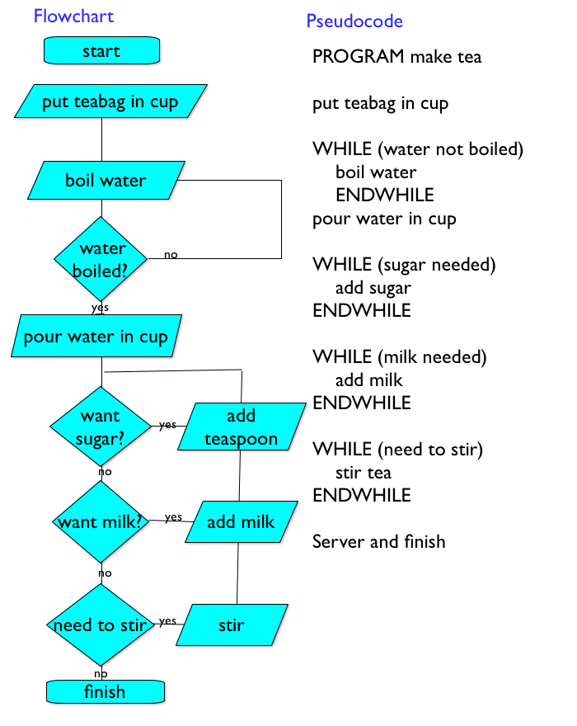
Algorithm
“Most optimal solution to a problem”
What is a Flowchart?
What is a Pseudocode?
Let’s solve:
Ex1: by me
Ex2: together
Ex3: by you
Notes:
Bu Slidedan sonra draw.io-da 2-3 xirda besit misal ishlenilsin
1 misali muellim ozu ishlesin
1 misal telebelerle birlikde
1 misal da ozleri hell elesinler
N ededine qeder cut ededleri goster:
Put n
While(n=0)
if(n%2=0)
Print n
End if
n-1
End while
N faktorial hesablamaq:
Put n
Set result=1
While(n>1)
result=result*n
N-1
End While
Print result

Slide 15
Thanks!

